Slide 1
Chapter -4
Signal conditioning
Signal conditioning: is one of the element for measurement system to get the measurand value. This step takes the output of the sensing element and converts it into a form more suitable for further processing, usually a d.c voltage, d.c current or frequency signal.
Bridge circuits
Bridge circuits are used very commonly as a variable conversion element in measurement systems and produce an output in the form of a voltage level that changes as the measured physical quantity changes.
Also it uses to measure dc resistance on bridge circuit.

Slide 2
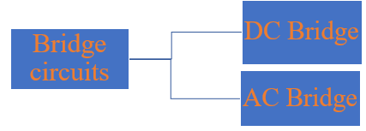
DC Bridges it uses DC excitation to measure the unknown resistance and out put voltage. It also contains resistance only on the circuit.
AC Bridges it uses AC excitation to measure unknown impedance and out put frequency . It also contains resistance, inductance and capacitance on the circuit.

Slide 3
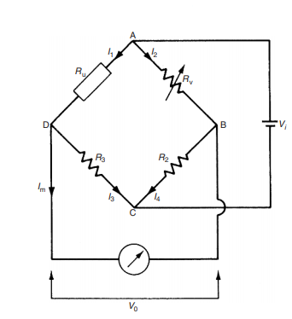
Null-type, d.c bridges(Wheatstone bridge)
A null-type bridge with d.c excitation, commonly known as a Wheatstone bridge. The four arms of the bridge consist of the unknown resistance Ru, two equal value resistors R2 and R3 and a variable resistor Rv.
A d.c voltage Vi is applied across the points AC and the resistance Rv is varied until the voltage measured across points BD is zero.

Slide 4
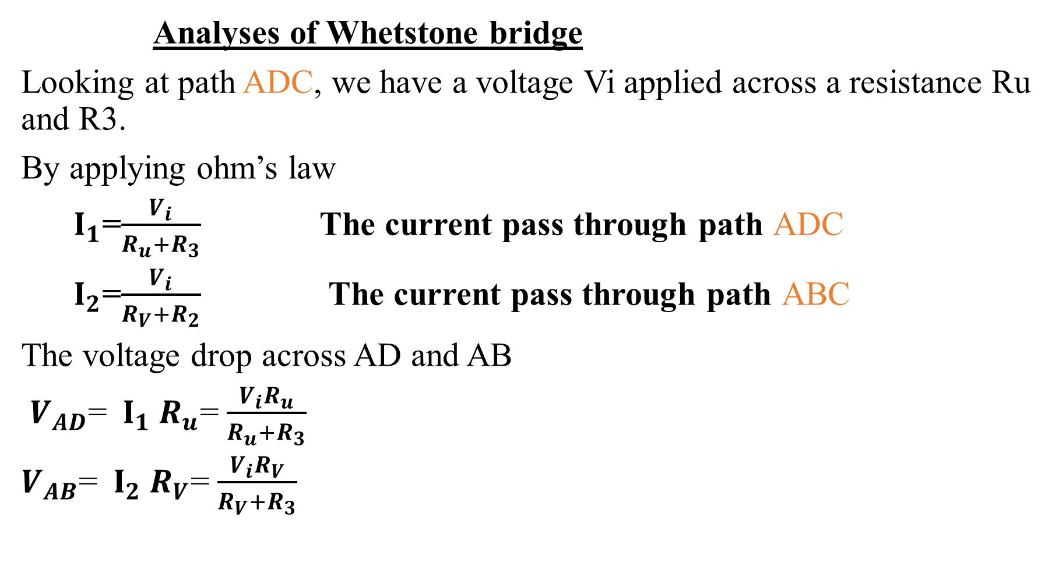
Analyses of Whetstone bridge
Looking at path ADC, we have a voltage Vi applied across a resistance Ru and R3.
By applying ohm’s law
${ I}_{1}$=$\frac{V_{i}}{R_{u}+R_{3}}$ The current pass through path ADC
${ I}_{2}$=$\frac{V_{i}}{R_{V}+R_{2}}$ The current pass through path ABC
The voltage drop across AD and AB
$V_{AD}$= ${ I}_{1}$ $R_{u}$= $\frac{V_{i}R_{u}}{R_{u}+R_{3}}$
$V_{AB}$= ${ I}_{2}$ $R_{V}$= $\frac{V_{i}R_{V}}{R_{V}+R_{3}}$

Slide 5
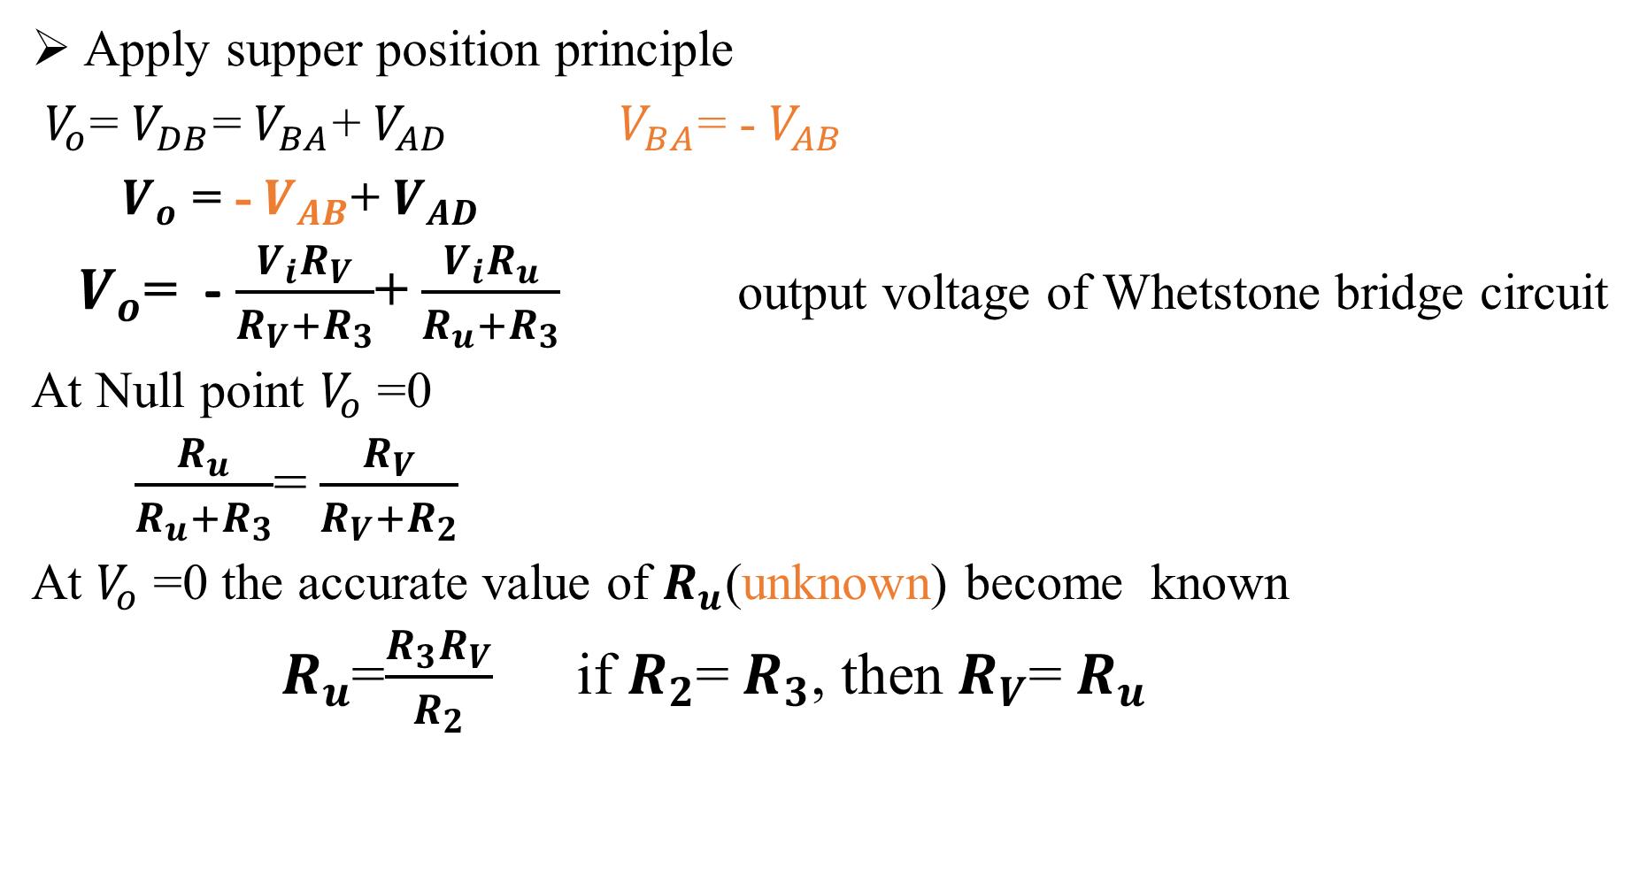
Apply supper position principle
$V_{o}$= $V_{DB}$= $V_{BA}$+ $V_{AD}$ $V_{BA}$= - $V_{AB}$
$V_{o}$ = - $V_{AB}$+ $V_{AD}$
$V_{o}$= - $\frac{V_{i}R_{V}}{R_{V}+R_{3}}$+ $\frac{V_{i}R_{u}}{R_{u}+R_{3}}$ output voltage of Whetstone bridge circuit
At Null point $V_{o}$ =0
$\frac{R_{u}}{R_{u}+R_{3}}$= $\frac{R_{V}}{R_{V}+R_{2}}$
At $V_{o}$ =0 the accurate value of $R_{u}$(unknown) become known
${ R}_{u}$=$\frac{R_{3}R_{V}}{R_{2}}$ if $R_{2}$= $R_{3}$, then $R_{V}$= $R_{u}$

Slide 6
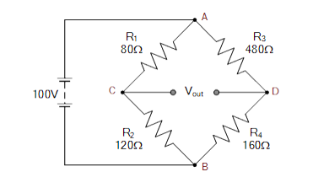
The following unbalanced Wheatstone bridge is constructed. Calculate the output voltage across points C and D and the value of resistor R4 required to balance the bridge circuit.

Slide 7
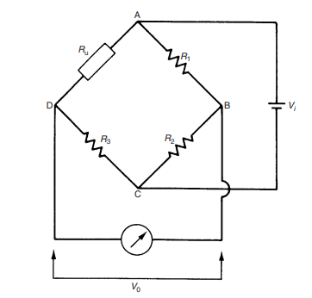
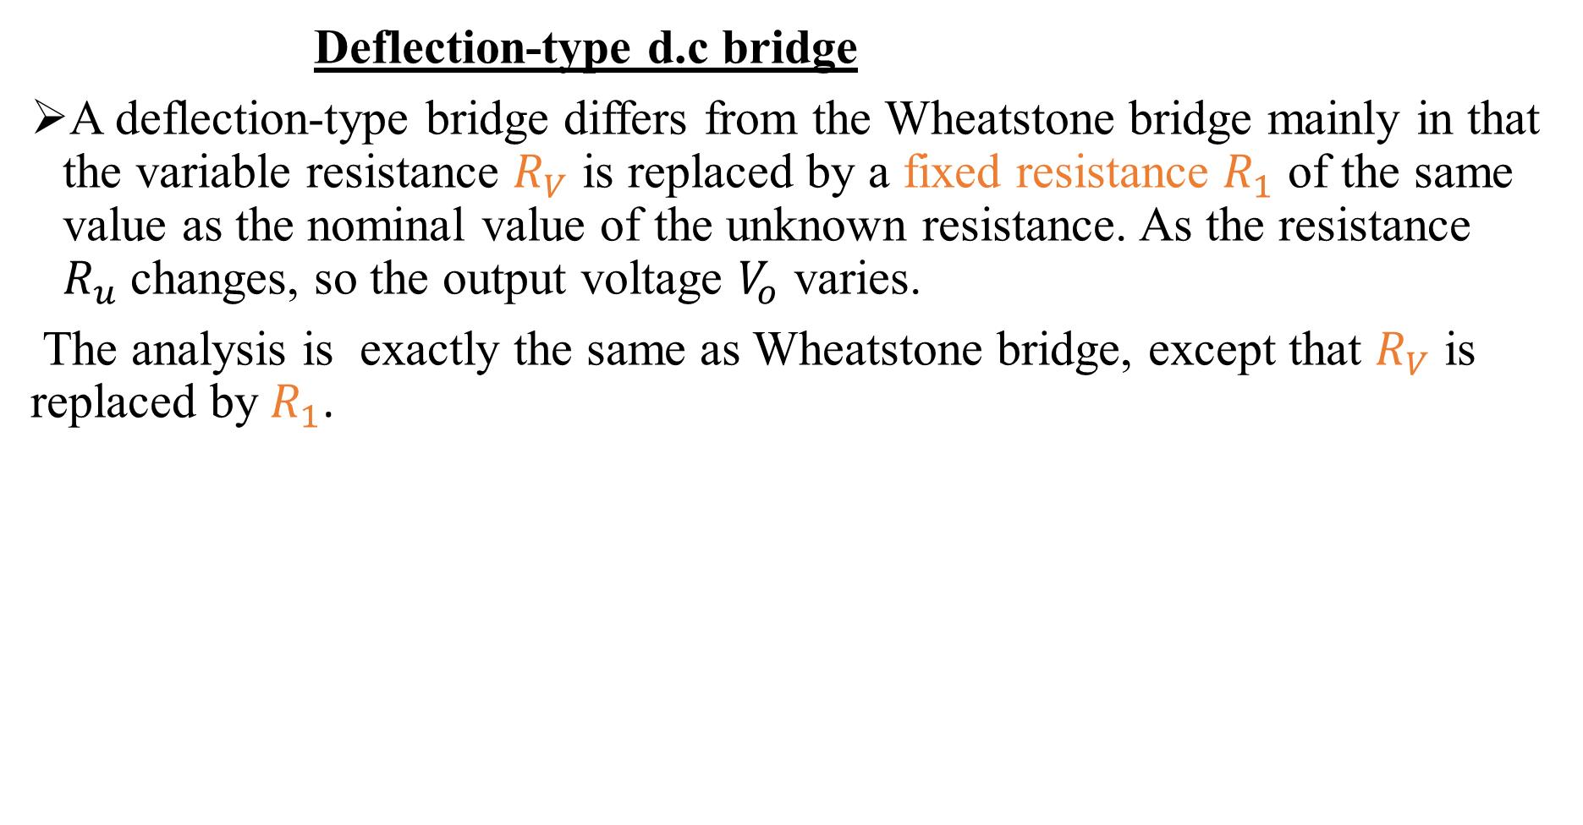
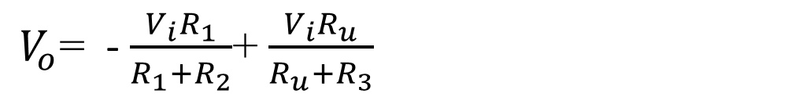
Deflection-type d.c bridge
A deflection-type bridge differs from the Wheatstone bridge mainly in that the variable resistance $R_{V}$ is replaced by a fixed resistance $R_{1}$ of the same value as the nominal value of the unknown resistance. As the resistance $R_{u}$changes, so the output voltage $V_{o}$ varies.
The analysis is exactly the same as Wheatstone bridge, except that $R_{V}$ is replaced by $R_{1}$.
$V_{o}$= - $\frac{V_{i}R_{1}}{R_{1}+R_{2}}$+ $\frac{V_{i}R_{u}}{R_{u}+R_{3}}$
output voltage of Deflection-type d.c bridge circuit

Slide 8
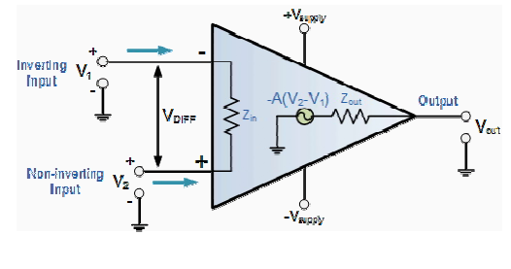

Operational Amplifiers
operational amplifier is an electronic device that has two input terminals and one output terminal, the two inputs being known as the inverting input and non-inverting input respectively.
The output signal is the amplification factor, known as the amplifiers gain (A) multiplied by the value of the input signal and depending on the nature of these input and output signals.

Slide 9
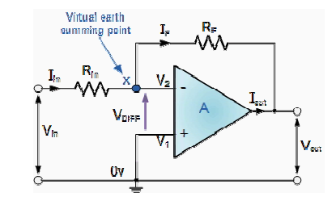
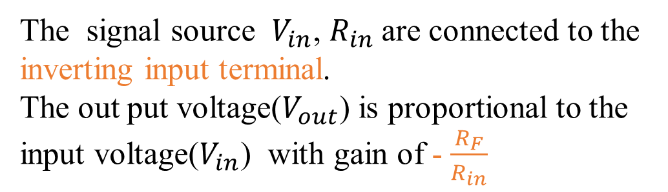
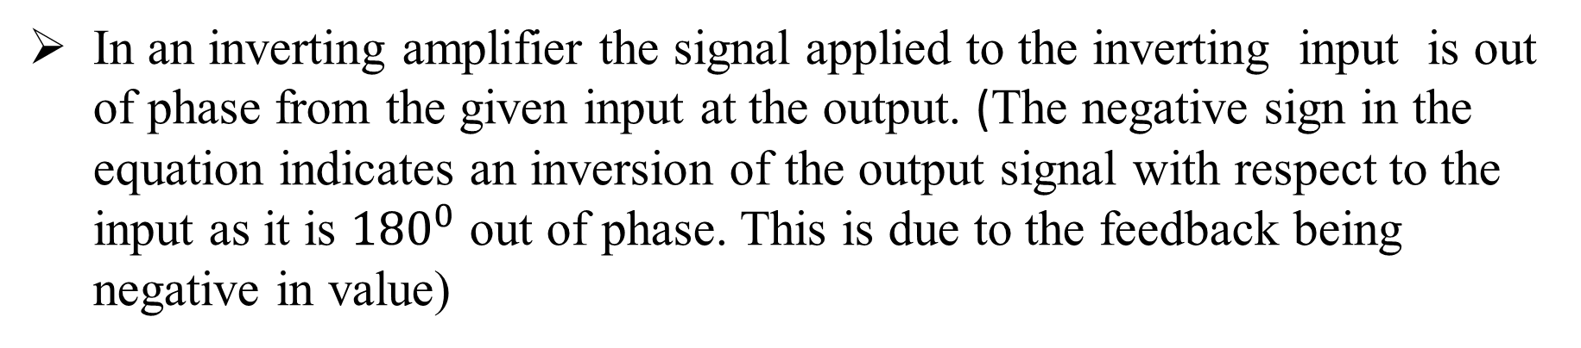
Inverting Amplifier
The signal source $V_{in}$, $R_{in}$are connected to the inverting input terminal.
The out put voltage($V_{out}$) is proportional to the input voltage($V_{in}$) with gain of - $\frac{R_{F}}{R_{in}}$
In an inverting amplifier the signal applied to the inverting input is out of phase from the given input at the output. (The negative sign in the equation indicates an inversion of the output signal with respect to the input as it is ${180}^{0}$ out of phase. This is due to the feedback being negative in value)

Slide 10
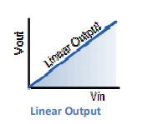
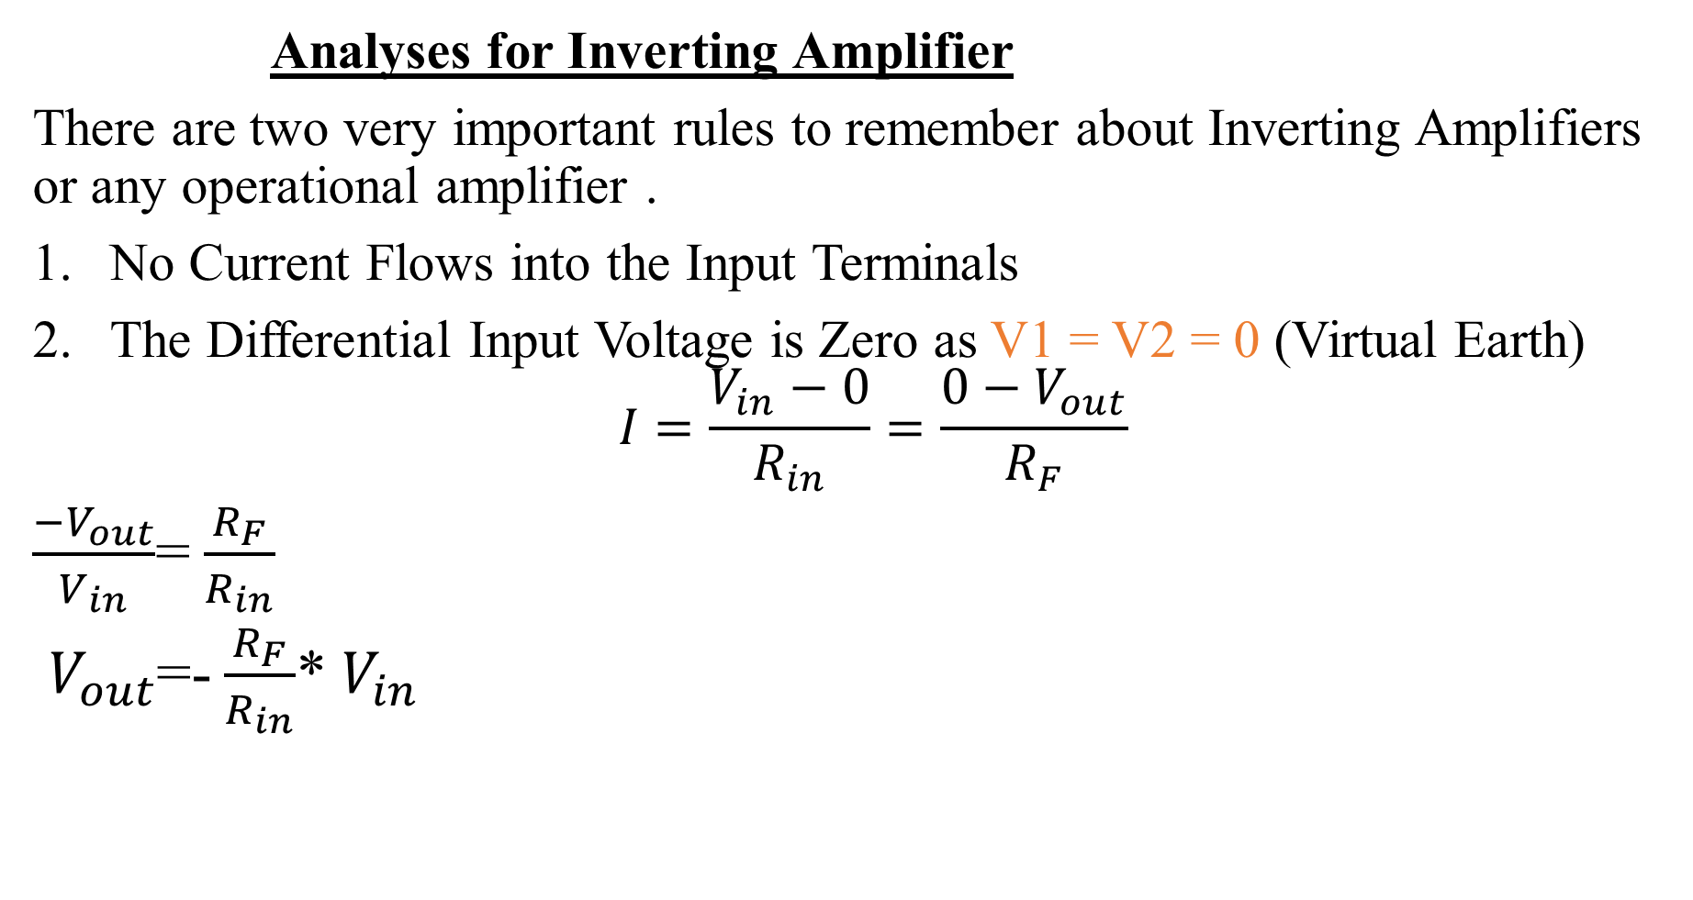
Analyses for Inverting Amplifier
There are two very important rules to remember about Inverting Amplifiers or any operational amplifier .
No Current Flows into the Input Terminals
The Differential Input Voltage is Zero as V1 = V2 = 0 (Virtual Earth)
$$I=\frac{V_{in}−0}{R_{in}}=\frac{0−V_{out}}{R_{F}}$$
$\frac{−V_{out}}{V_{in}}$= $\frac{R_{F}}{R_{in}}$
$V_{out}$=- $\frac{R_{F}}{R_{in}}$* $V_{in}$
closed loop voltage Gain (AV)
closed loop output voltage of inverting amplifier

Slide 11
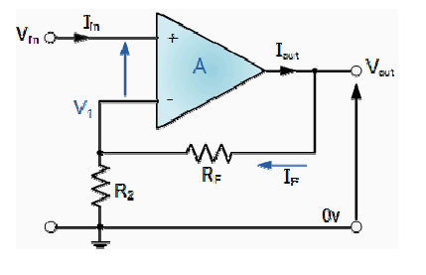
Non-Inverting Amplifier
Non-inverting Amplifier. In this configuration, the input voltage signal, (Vin) is applied directly to the non-inverting (+) input terminal which means that the output gain of the amplifier becomes "Positive" in value in contrast to the "Inverting Amplifier" circuit.
The result of this is that the output signal is "in-phase" with the input signal.
This closed-loop configuration produces a non-inverting amplifier circuit with very good stability, a very high input impedance, Rin approaching infinity, as no current flows into the positive input terminal, (ideal conditions) and a low output impedance.

Slide 12

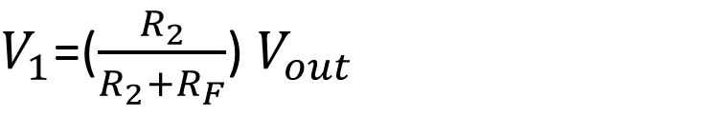
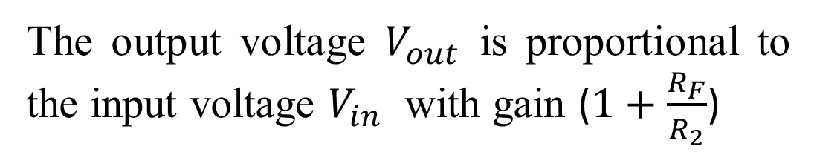
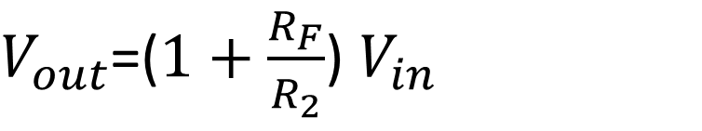
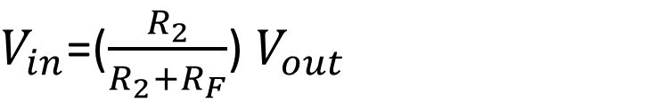
Analyses for Non-Inverting Amplifier
$V_{1}$=($\frac{R_{2}}{R_{2}+R_{F}}$) $V_{out}$
At ideal summing point $V_{1}$= $V_{in}$
$V_{in}$=($\frac{R_{2}}{R_{2}+R_{F}}$) $V_{out}$
The output voltage $V_{out}$ is proportional to the input voltage $V_{in}$ with gain ($1+\frac{R_{F}}{R_{2}}$)
$V_{out}$=($1+\frac{R_{F}}{R_{2}}$) $V_{in}$

Slide 13
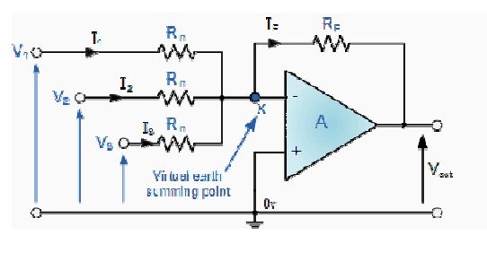
Summing amplifier(inverting summing amplifier)
Summing amplifier works based upon the standard Inverting Operational Amplifier configuration that can be used for combining multiple inputs.
An operational amplifier circuit that will amplify each individual input voltage and produce an output voltage signal that is proportional to the algebraic "SUM" of the three individual input voltages V1, V2 and V3
Summing amplifier is used for
summing, averaging, scaling
Digital to analog converter
For different audio mixer

Slide 14
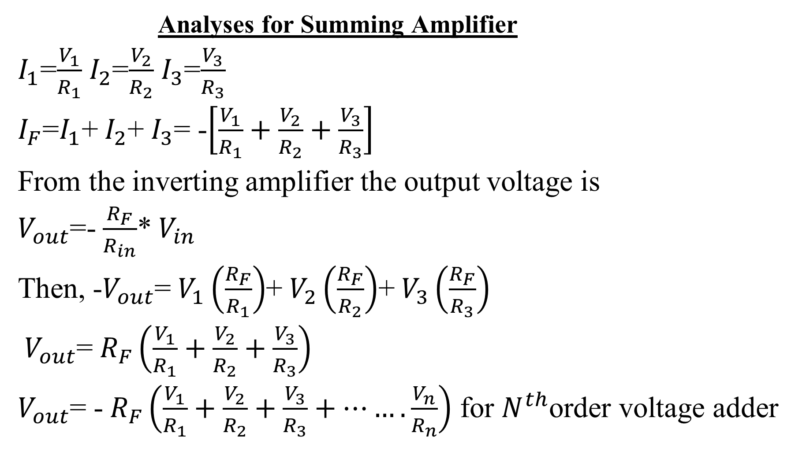
Analyses for Summing Amplifier
$I_{1}$=$\frac{V_{1}}{R_{1}}$ $I_{2}$=$\frac{V_{2}}{R_{2}}$ $I_{3}$=$\frac{V_{3}}{R_{3}}$
$I_{F}$=$I_{1}$+ $I_{2}$+ $I_{3}$= -$\left[\frac{V_{1}}{R_{1}}+\frac{V_{2}}{R_{2}}+\frac{V_{3}}{R_{3}}\right]$
From the inverting amplifier the output voltage is
$V_{out}$=- $\frac{R_{F}}{R_{in}}$* $V_{in}$
Then, -$V_{out}$= $V_{1}\left(\frac{R_{F}}{R_{1}}\right)$+ $V_{2}\left(\frac{R_{F}}{R_{2}}\right)$+ $V_{3}\left(\frac{R_{F}}{R_{3}}\right)$
$V_{out}$= $R_{F}\left(\frac{V_{1}}{R_{1}}+\frac{V_{2}}{R_{2}}+\frac{V_{3}}{R_{3}}\right)$
$V_{out}$= - $R_{F}\left(\frac{V_{1}}{R_{1}}+\frac{V_{2}}{R_{2}}+\frac{V_{3}}{R_{3}}+…….\frac{V_{n}}{R_{n}}\right)$ for $N^{th}$order voltage adder

Slide 15
Chapter -5
Signal Processing
Signal processing takes the output of the conditioning element and converts it into a form more suitable for presentation. Signal processing takes depends on the software program executed by the processor.
Types of those converters
Analog to Digital (A/D) converters
Digital to Analog (D/A ) converters

Slide 16
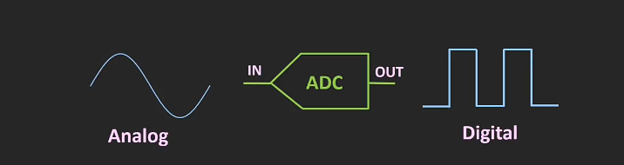
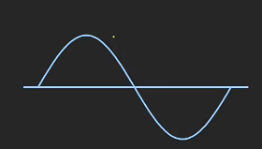
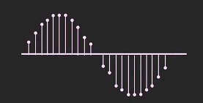
Analog to Digital (A/D) converters
Analogue to digital conversion is a process of turning an analogue voltage or current into a digital pattern which can be read by a computer and processed.
Three operations involved in A/D conversion: these are sampling, quantization and encoding.
Sampling: is the reduction of a continuous time signal in to a discrete time signal.

Slide 17
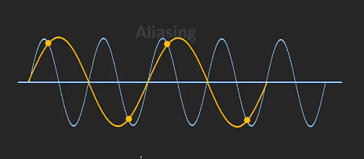
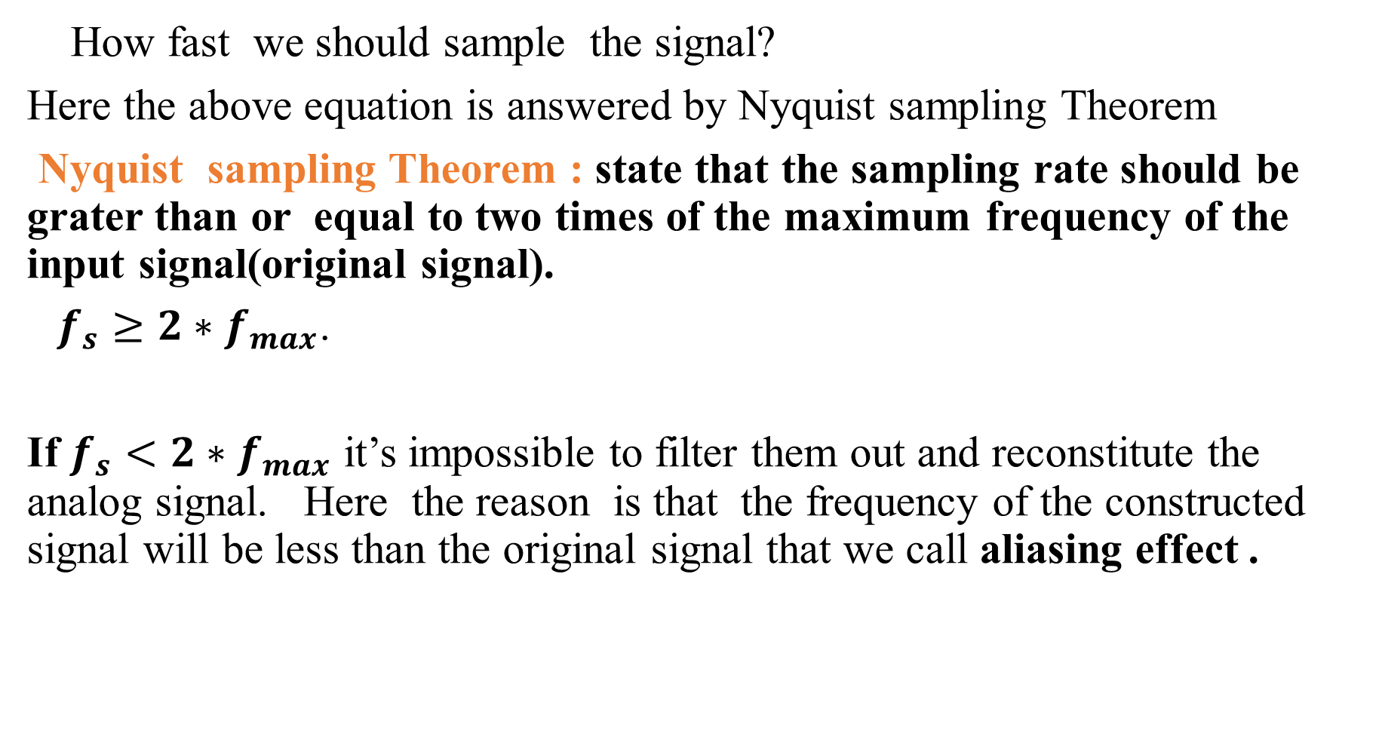
How fast we should sample the signal?
Here the above equation is answered by Nyquist sampling Theorem
Nyquist sampling Theorem : state that the sampling rate should be grater than or equal to two times of the maximum frequency of the input signal(original signal).
$f_{s}≥2∗$ $f_{max}$.
If $f_{s}<2∗$ $f_{max}$ it’s impossible to filter them out and reconstitute the analog signal. Here the reason is that the frequency of the constructed signal will be less than the original signal that we call aliasing effect .
It's possible to filter out the sampling components and reconstitute the analog signal.

Slide 18
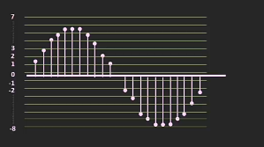
Quantization: is the process of assigning a sampled signal a value from the discrete set of values.(it the process of converting continuous range of amplitude values in to a limited discrete set of value )
We should have to know those points before quantization
Number of bit of ADC
How many number of binary bits the ADC can represent the digital out put.
Resolution(the minimum change in the input signal which can be detected by the ADC)

Slide 19
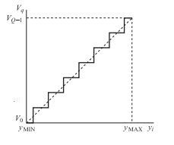
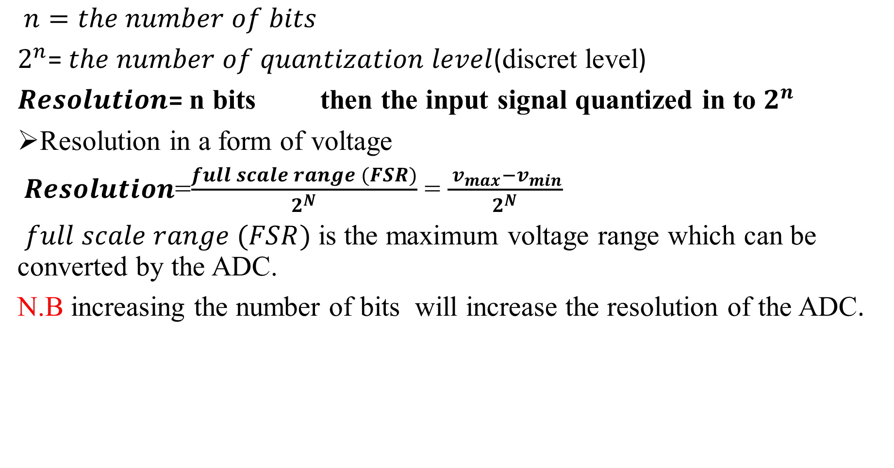
$n=the number of bits$
$2^{n}$= $the number of quantization level$(discret level)
$Resolution$= n bits then the input signal quantized in to $2^{n}$
Resolution in a form of voltage
$Resolution$=$\frac{full scale range (FSR)}{2^{N}}$ = $\frac{{ v}_{max}−v_{min}}{2^{N}}$
$full scale range (FSR)$ is the maximum voltage range which can be converted by the ADC.
N.B increasing the number of bits will increase the resolution of the ADC.
Quantized signal

Slide 20
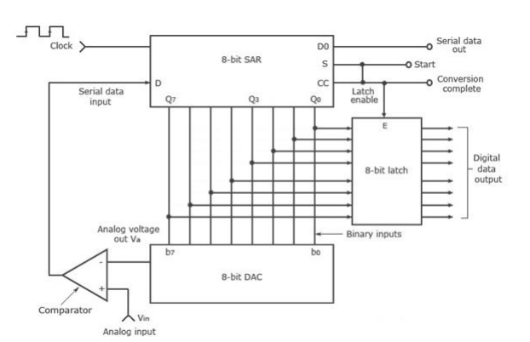
Encoding: it converts the quantization values into a parallel digital signal corresponding to a binary coded version of the decimal numbers.
Types of A/D converters
Successive approximation ADC
A successive approximation A/D converter consists of a comparator, a successive approximation register (SAR), output latches, and a D/A converter.

Slide 21
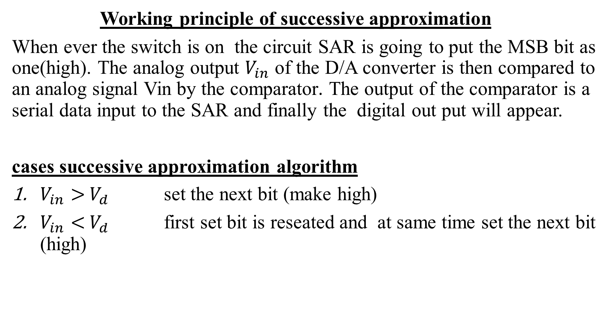
Working principle of successive approximation
When ever the switch is on the circuit SAR is going to put the MSB bit as one(high). The analog output $V_{in}$ of the D/A converter is then compared to an analog signal Vin by the comparator. The output of the comparator is a serial data input to the SAR and finally the digital out put will appear.
cases successive approximation algorithm
$V_{in}>$ $V_{d}$ set the next bit (make high)
$V_{in}<$ $V_{d}$ first set bit is reseated and at same time set the next bit (high)

Slide 22
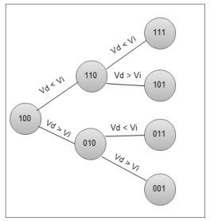
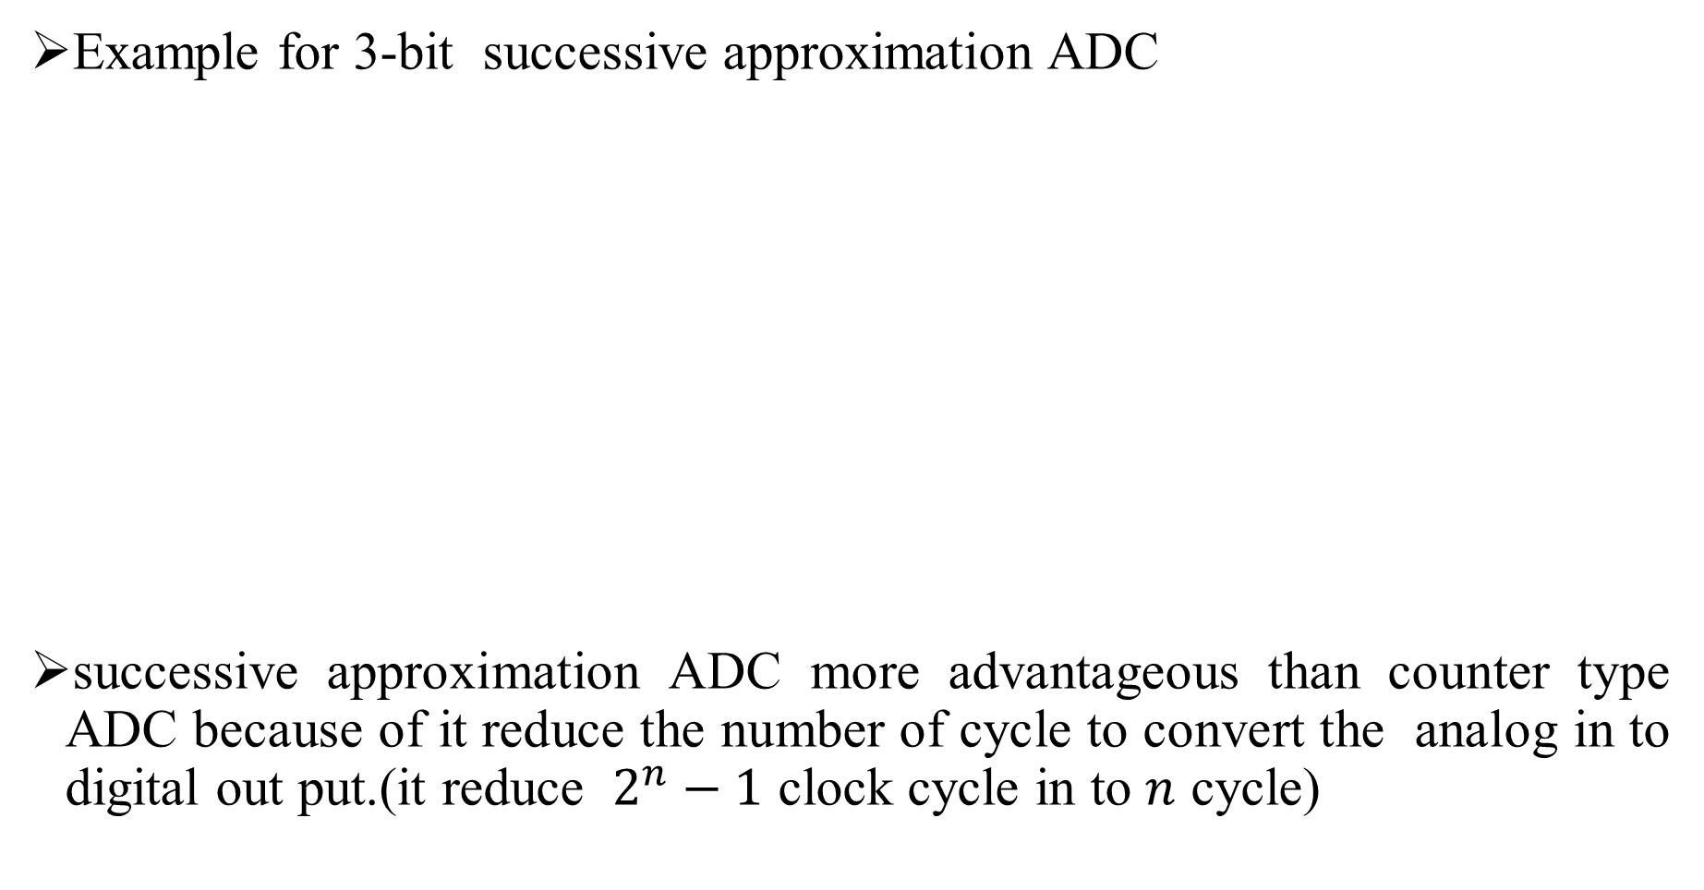
Example for 3-bit successive approximation ADC
successive approximation ADC more advantageous than counter type ADC because of it reduce the number of cycle to convert the analog in to digital out put.(it reduce $2^{n}−1$ clock cycle in to $n$ cycle)

Slide 23
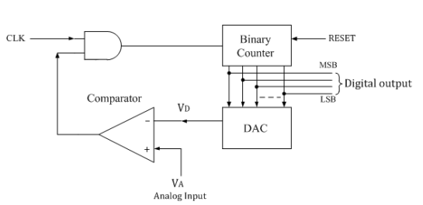
Counter type ADC
The Counter type ADC can be defined as, it is the basic type of ADC, which is also known as staircase approximation ADC, or a ramp type ADC. The N-bit counter produces an n-bit digital o/p which is given as an i/p to the digital to analog circuit (DAC).

Slide 24
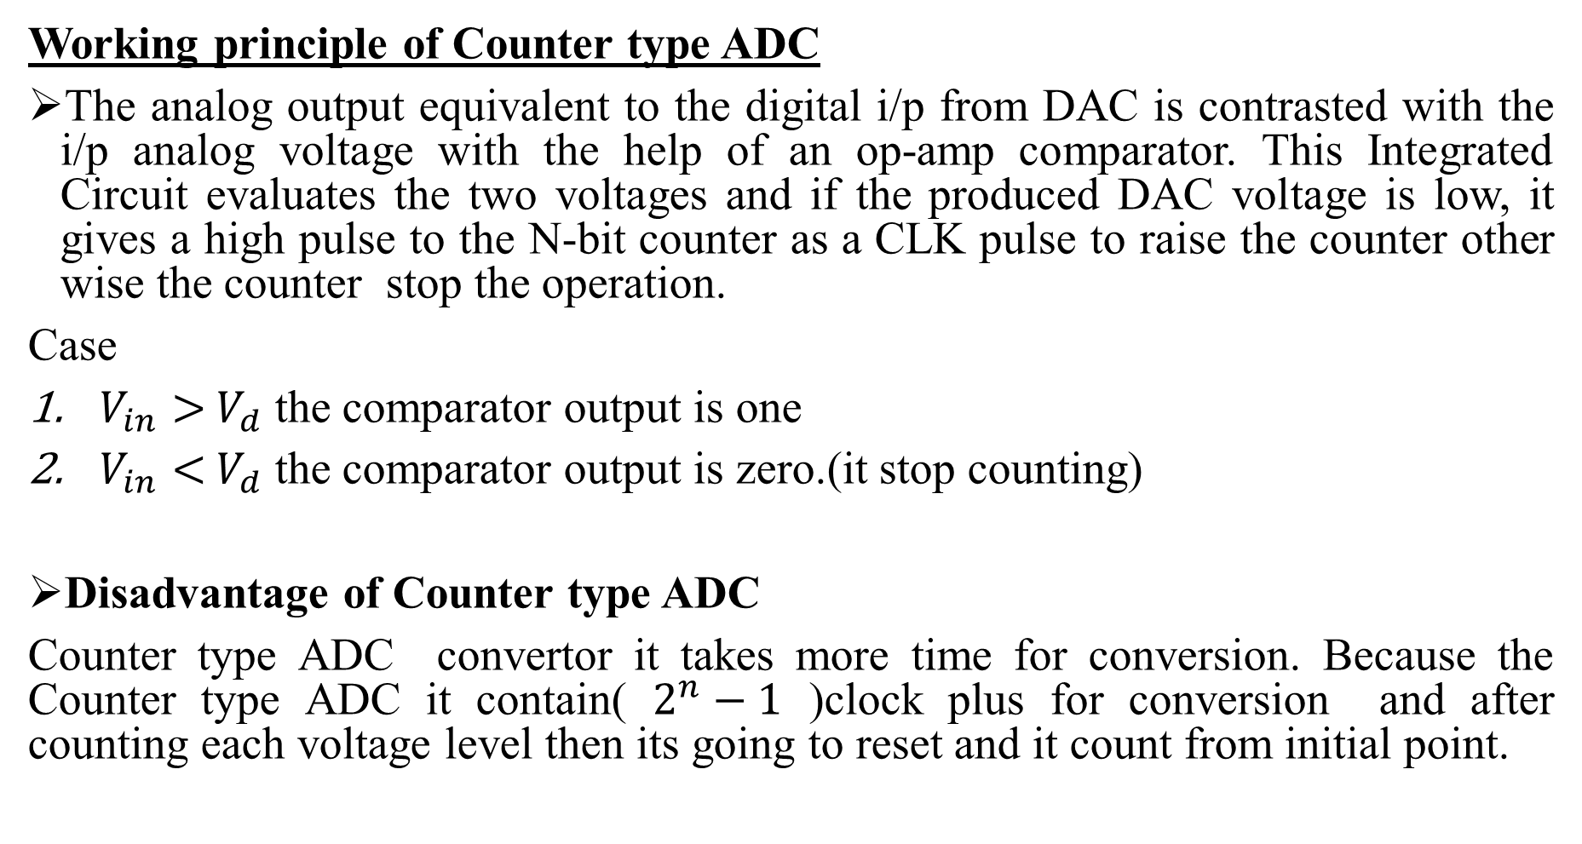
Working principle of Counter type ADC
The analog output equivalent to the digital i/p from DAC is contrasted with the i/p analog voltage with the help of an op-amp comparator. This Integrated Circuit evaluates the two voltages and if the produced DAC voltage is low, it gives a high pulse to the N-bit counter as a CLK pulse to raise the counter other wise the counter stop the operation.
Case
$V_{in}>$ $V_{d}$ the comparator output is one
$V_{in}<$ $V_{d}$ the comparator output is zero.(it stop counting)
Disadvantage of Counter type ADC
Counter type ADC convertor it takes more time for conversion. Because the Counter type ADC it contain( $2^{n}−1$ )clock plus for conversion and after counting each voltage level then its going to reset and it count from initial point.

Slide 25
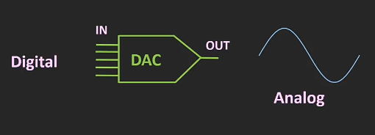
Digital to Analog converters
The process of converting a digital data in to an equivalent analog signal is
Known as digital to analog conversion and the circuit that converts data is known as ADC.
The convertor circuit input is N- bit parallel data ,such as ,2 bit,4 bit,8 bit etc.

Slide 26
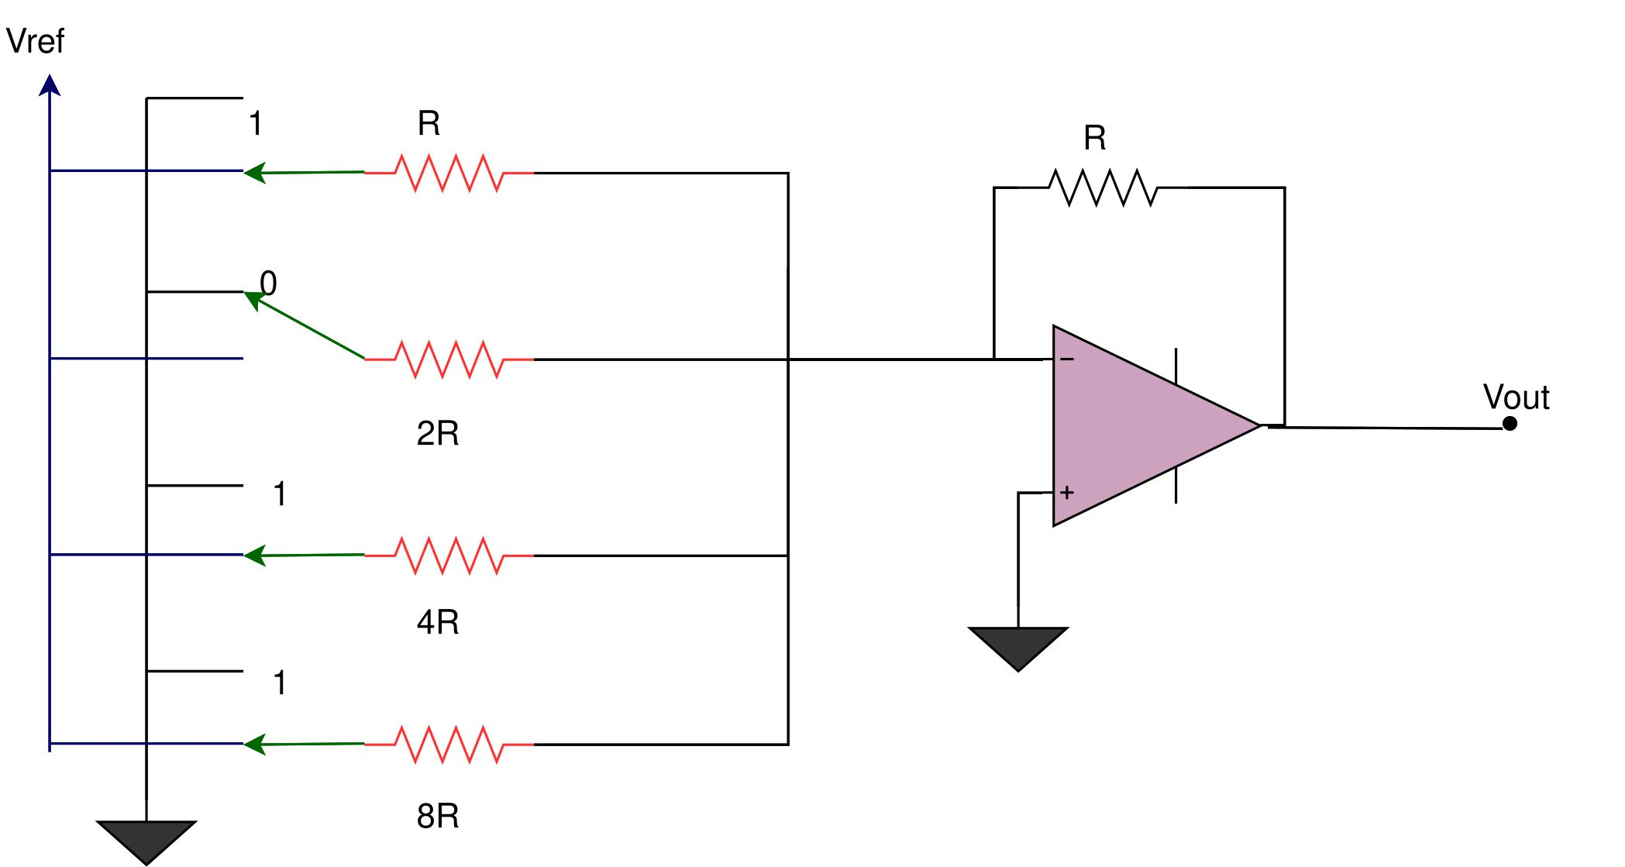
Types of D/A converters
Binary weighted DAC
A binary weighted DAC each bit signal is connected with weighted resistor and the MSB input is connected with lowest resistor and towards LSB the resistance value is made twice of previous resistor.(have different resistance value).
Here the purpose of increasing the resistor value is to pass minimum current through LSB resistance ,while maximum current through MSB resistor.
For 4-bit digital input

Slide 27
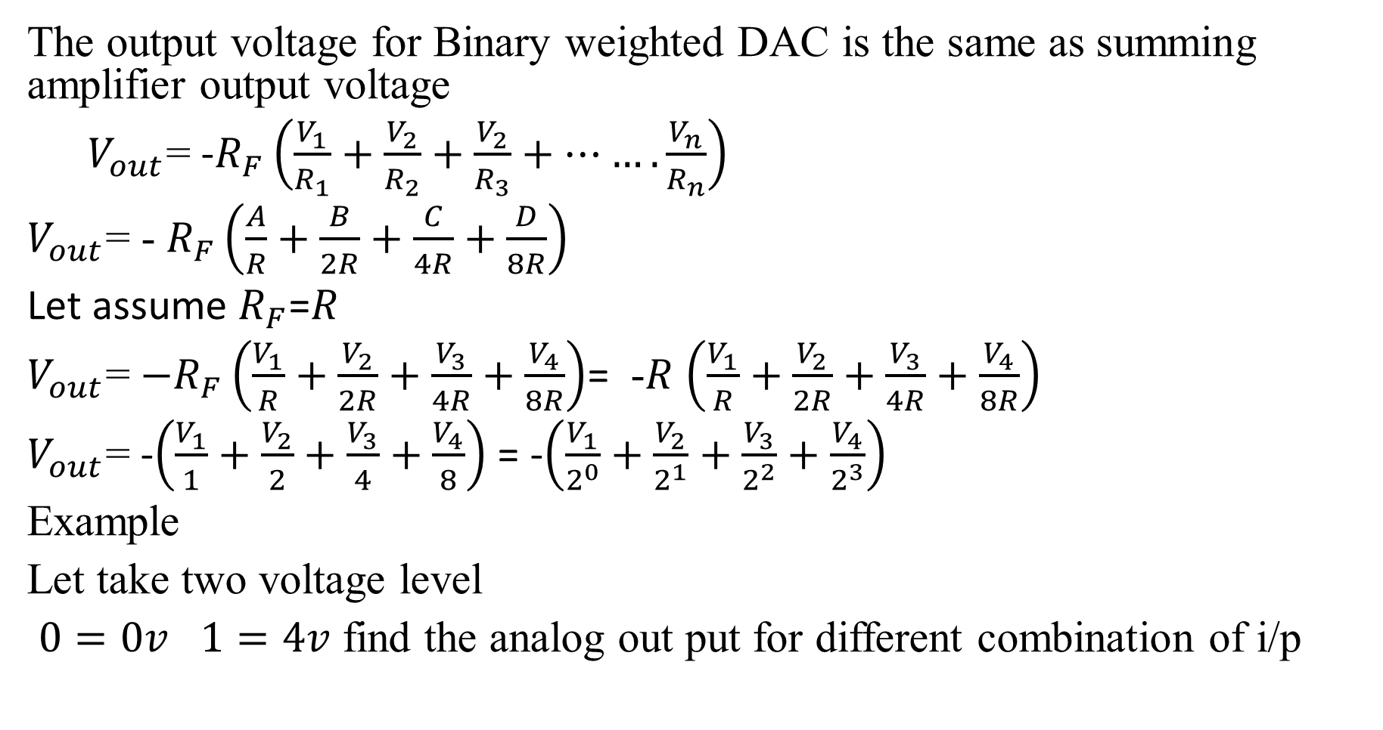
The output voltage for Binary weighted DAC is the same as summing amplifier output voltage
$V_{out}$= -$R_{F}\left(\frac{V_{1}}{R_{1}}+\frac{V_{2}}{R_{2}}+\frac{V_{2}}{R_{3}}+…….\frac{V_{n}}{R_{n}}\right)$
$V_{out}$= - $R_{F}\left(\frac{A}{R}+\frac{B}{2R}+\frac{C}{4R}+\frac{D}{8R}\right)$
Let assume $R_{F}$=$R$
$V_{out}$= ${−R}_{F}\left(\frac{V_{1}}{R}+\frac{V_{2}}{2R}+\frac{V_{3}}{4R}+\frac{V_{4}}{8R}\right)$= -$R$ $\left(\frac{V_{1}}{R}+\frac{V_{2}}{2R}+\frac{V_{3}}{4R}+\frac{V_{4}}{8R}\right)$
$V_{out}$= -$\left(\frac{V_{1}}{1}+\frac{V_{2}}{2}+\frac{V_{3}}{4}+\frac{V_{4}}{8}\right)$ = -$\left(\frac{V_{1}}{2^{0}}+\frac{V_{2}}{2^{1}}+\frac{V_{3}}{2^{2}}+\frac{V_{4}}{2^{3}}\right)$
Example
Let take two voltage level
$0=0v$ $1=4v$ find the analog out put for different combination of i/p

Slide 28
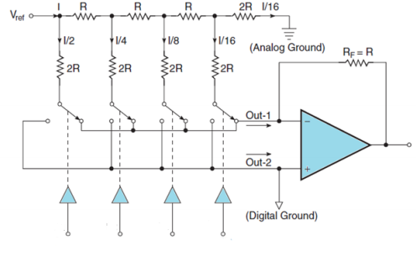
R-2R ladder DAC
Contains only two resistor value R and 2R and it has op-amp as a scaling circuit and MSB i/p towards right and LSB i/p with left of the circuit.

Slide 29
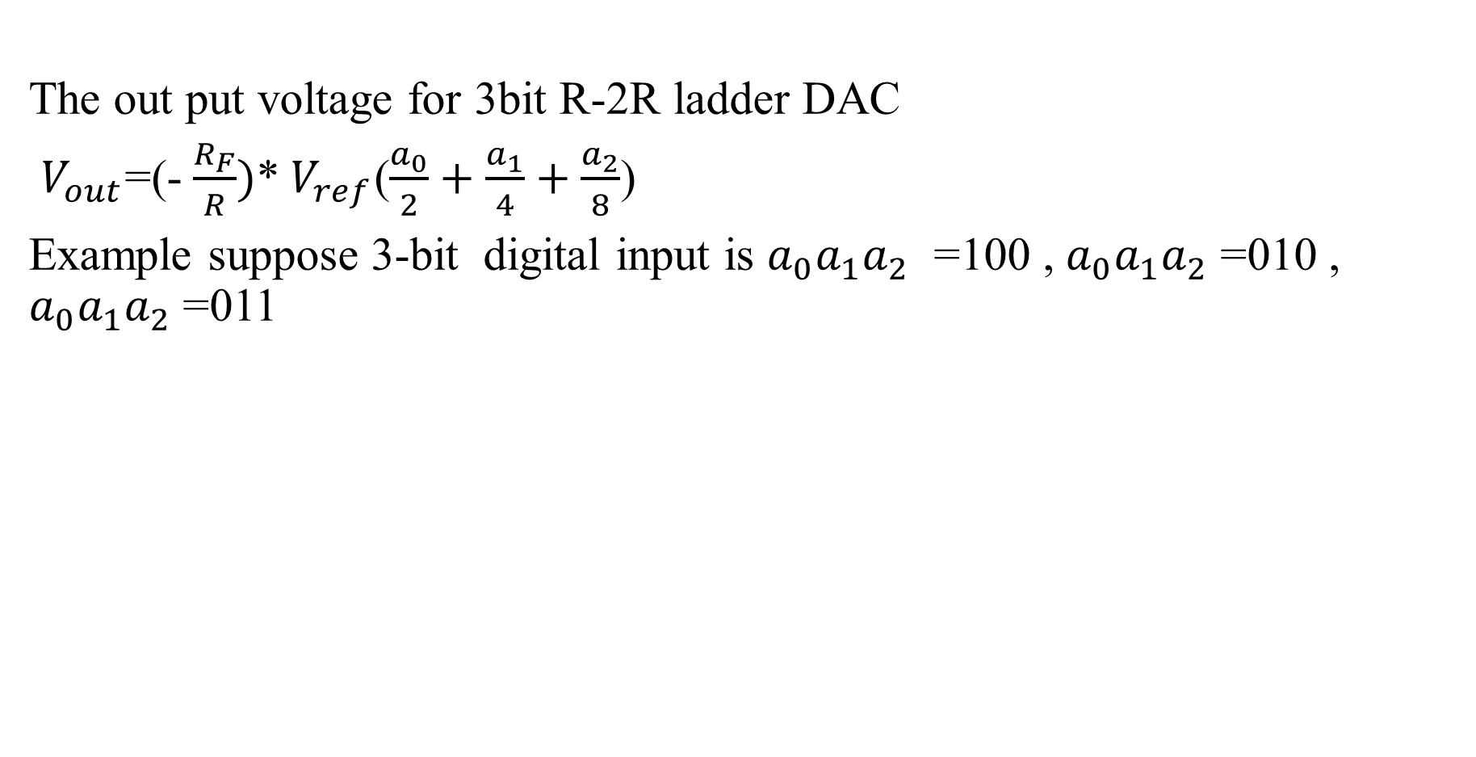
The out put voltage for 3bit R-2R ladder DAC
$V_{out}$=(- $\frac{R_{F}}{R})$* $V_{ref}$($\frac{a_{0}}{2}+\frac{a_{1}}{4}+\frac{a_{2}}{8}$)
Example suppose 3-bit digital input is $a_{0}a_{1}a_{2}$ =100 , $a_{0}a_{1}a_{2}$ =010 , $a_{0}a_{1}a_{2}$ =011

